Slide 1
Overview
K9 pipeline
FCR progess
WP 1: Evaluation of ERBB2 (human HER2) copy number variation in canine mammary tumors
WP 2: Identification of somatic variants by comparing exome data from tumor and normal tissue and the relationship with tumor stage, grade and clinical outcome
WP 3: Identification of somatic mutations in liquid biopsies and the use of these for diagnosis, monitoring disease relapse and progression.
Possible investigations
Questions

Slide 2
K9-WGS-Pipeline
Issues
Wrong paths to tools
Unclear what modules are needed
”Black box”
Function of different files
Flow through file(s)
Suggestions
Better README
More inline comments
No changes in the pipeline-file
All input given separately
Notes:
When you download the package, there’s a whole lot of files and stuff, that is very confusing. I still have no idea what half of the does. Some things are leftovers maybe?
User variables input, don’t know where.

Slide 3
K9-WGS-Pipeline - template
1 subfolder
1 file with variables to set/template
1 pipeline file
Up front check if all variables are set correctly
Notes:
Loads of clear error messages! Like if modules not there, then message ”You need to load your module”
A good Idea would be to have a
IS THERE A CHECK IF MODULE IS LOADED FUNCTION? If command: not exist then ERROR

Slide 4
Progress – Flatcoated Retrievers
Just finished the first runthrough!
The rest should finish in less than a week
Plan
Evaluating output
Collection/matching of phenotypes
GWAS
GSEA
Comparison with GR, and LR
Notes:
Can’t start because something i already running. Not touching that.
Hard filtering. Not recommended by gatk?
It outputs a file where it says INDEL, don’t know where that information is coming from.
Pooling different hematologic malignancies and finding commonalities.

Slide 5
Work packages
WP 1
Trip to Uppsala
July-October (or March-May)
At least 1 month
Design of assay
WP 2 and WP 3
Waiting on ethical approval
Start collection of cases
Majbritt’s substitute
VetGruppen
Notes:
Good courses at dtu in june.
Get an idea of how many samples are available for wp2

Slide 6
Possible investigations
Gene-expression in tumors
KIT, VEGF
Immunomodulation
Comparison between MCT and HS (LSA?)
Functional annotation (DAVID)

Slide 7
Questions
What kind of data is available/generatable
Exome
RNA
WG

Slide 8
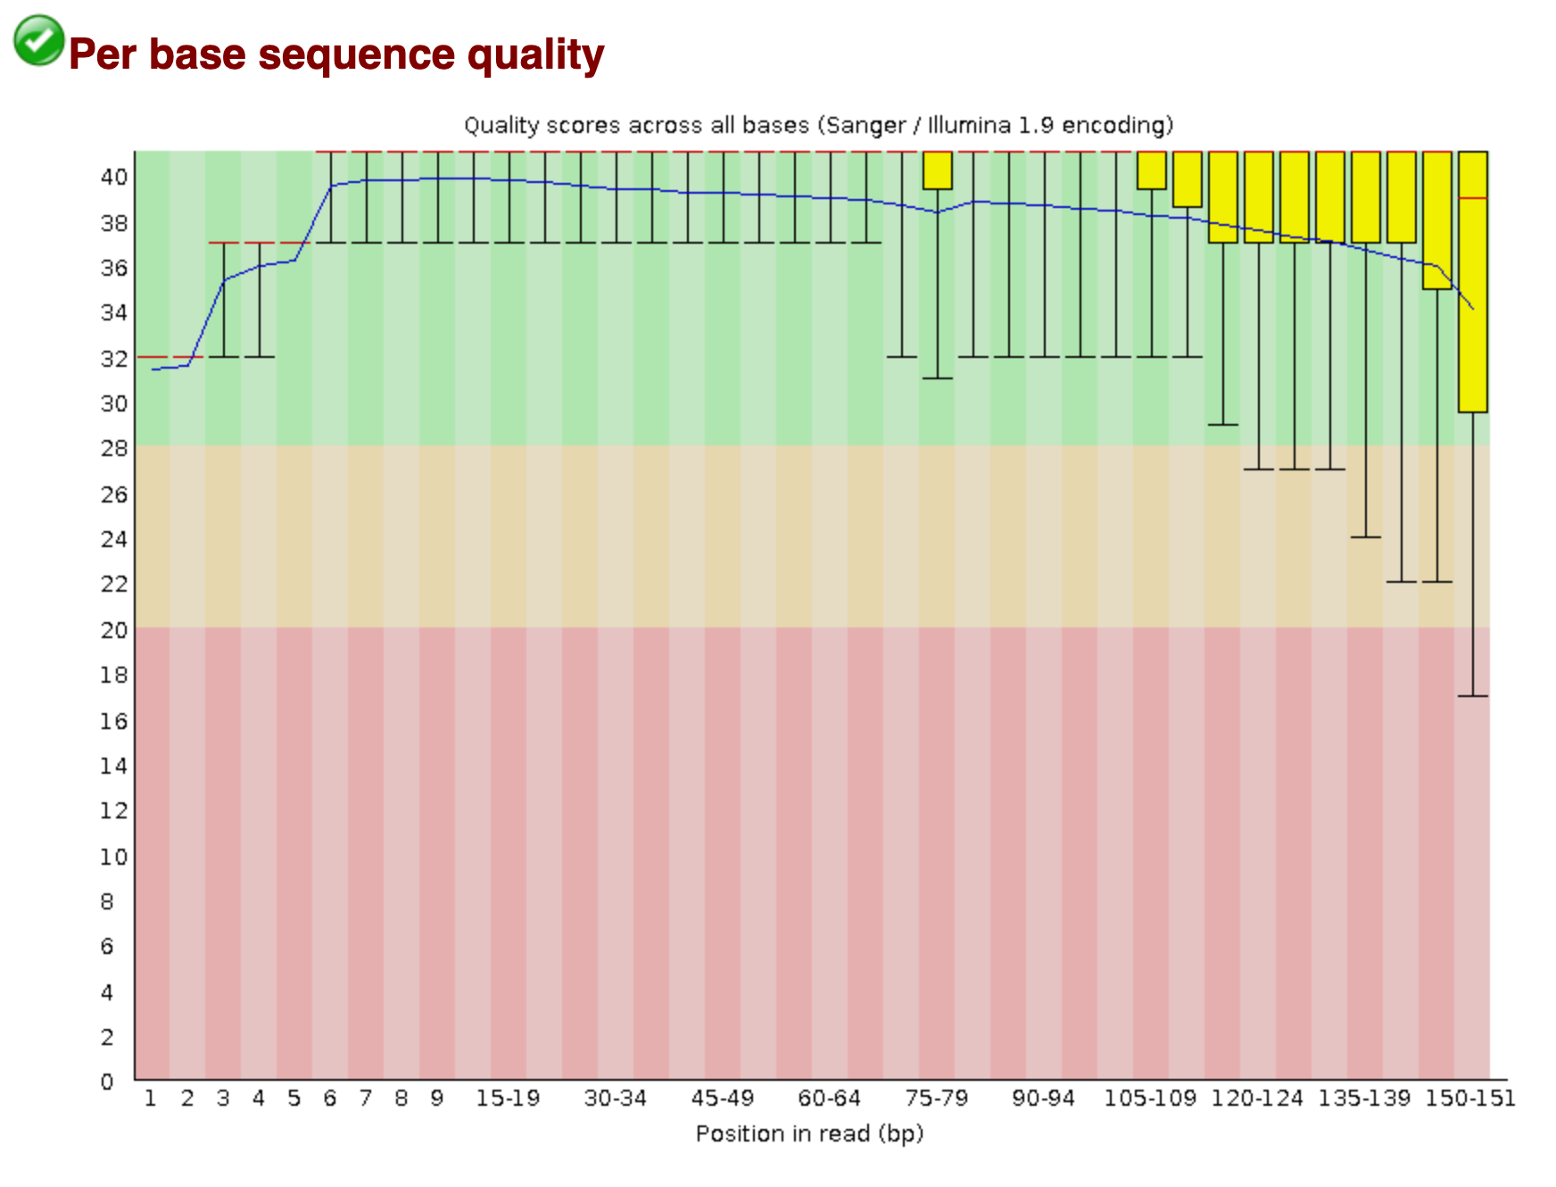
FastQC - Per base sequence quality

Slide 9
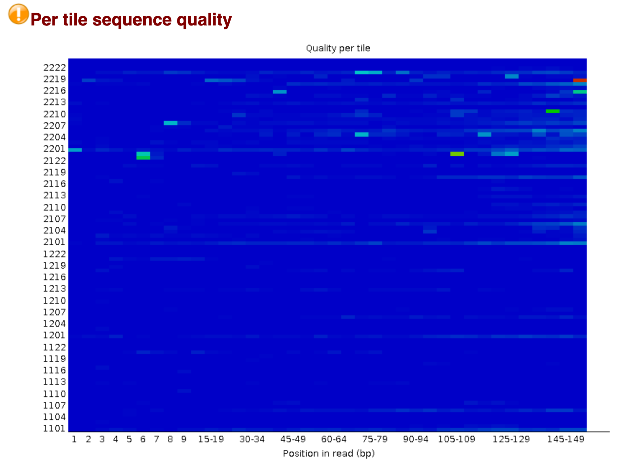
FastQC - Per tile sequence quality

Slide 10
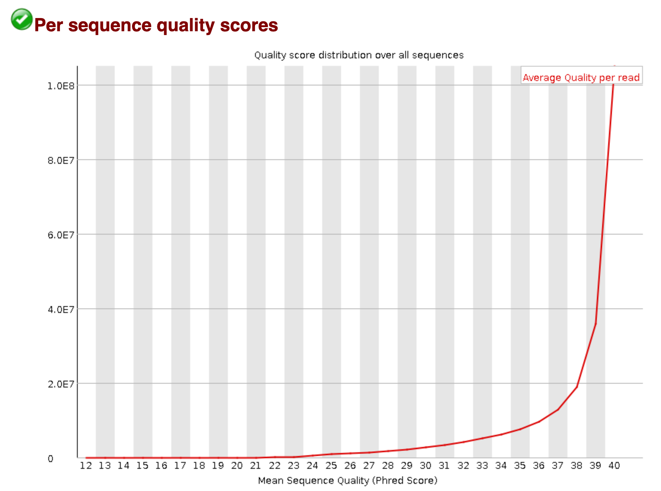
FastQC - Per sequence quality scores

Slide 11
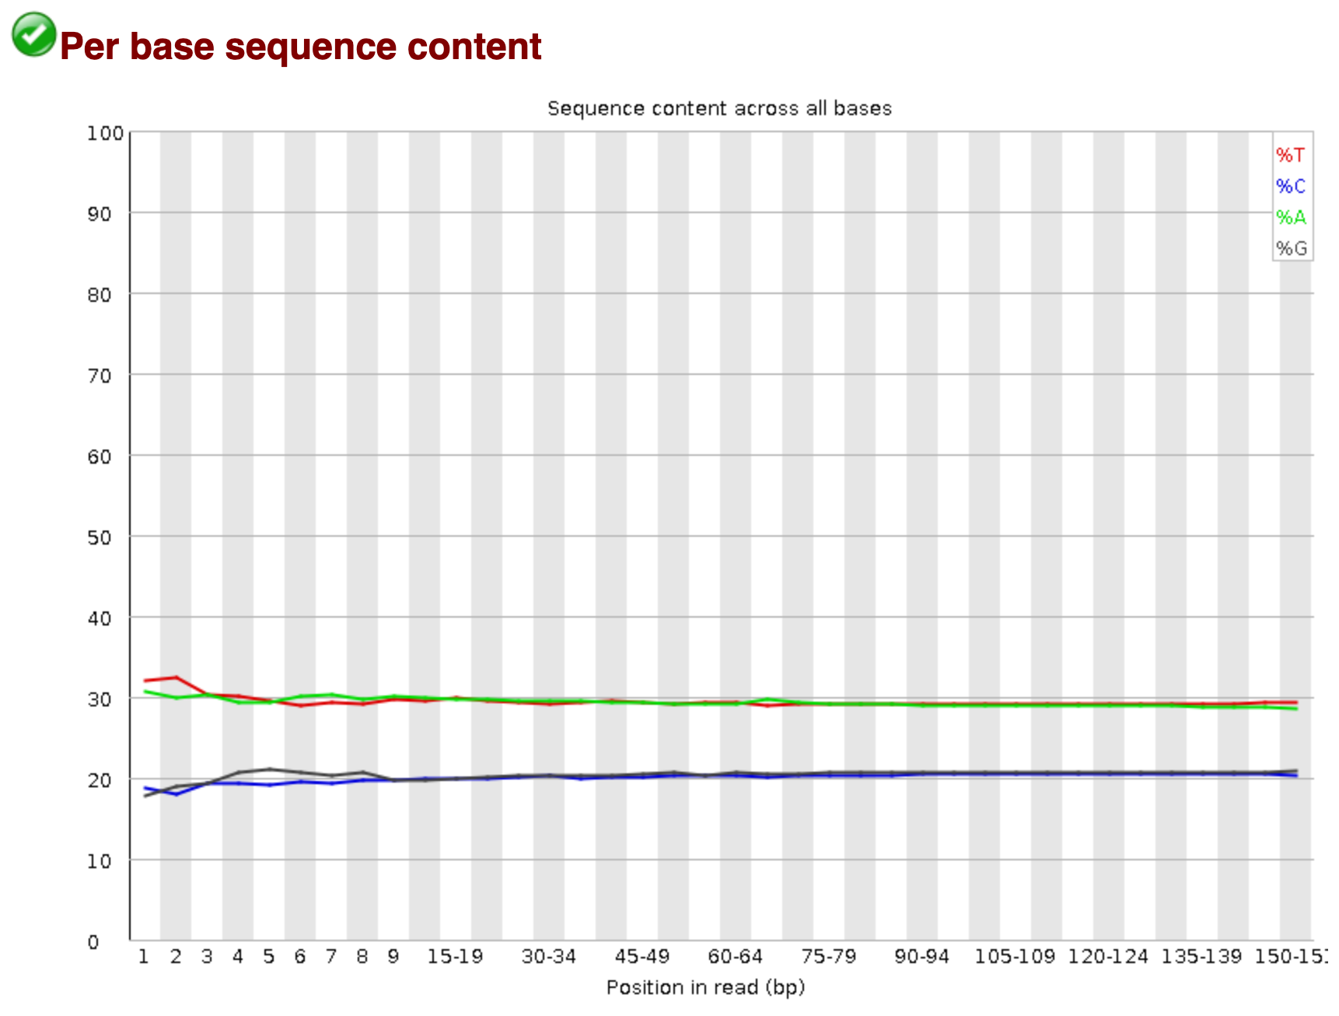
FastQC - Per base sequence content

Slide 12
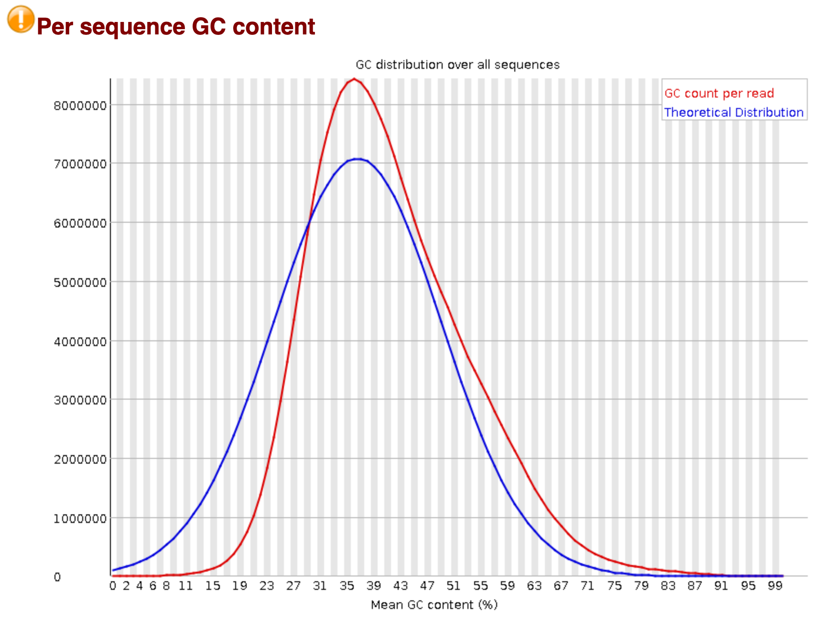
FastQC - Per sequence GC content

Slide 13
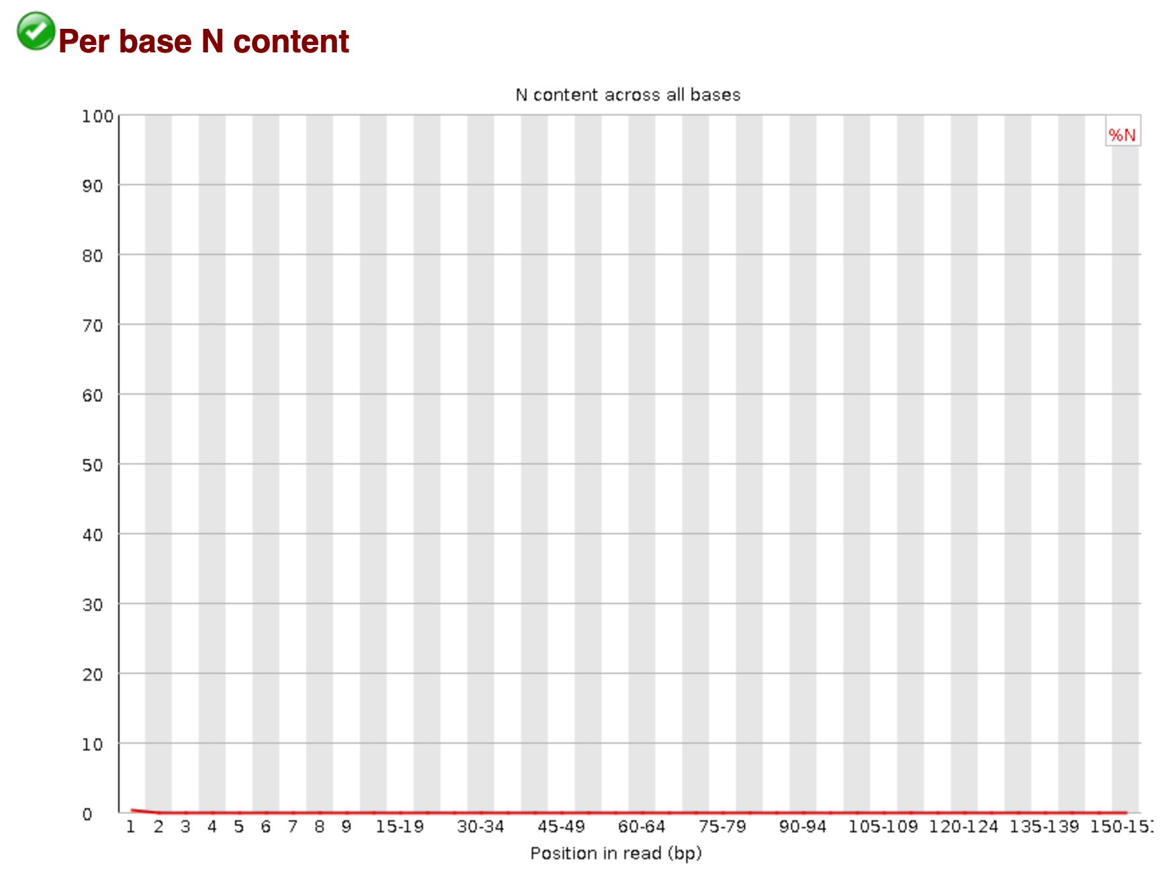
FastQC - Per base N content

Slide 14
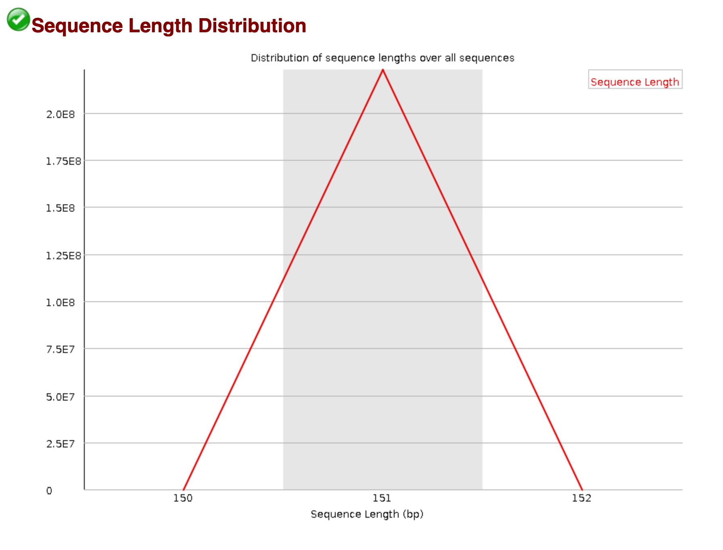
FastQC - Sequence Length Distribution

Slide 15
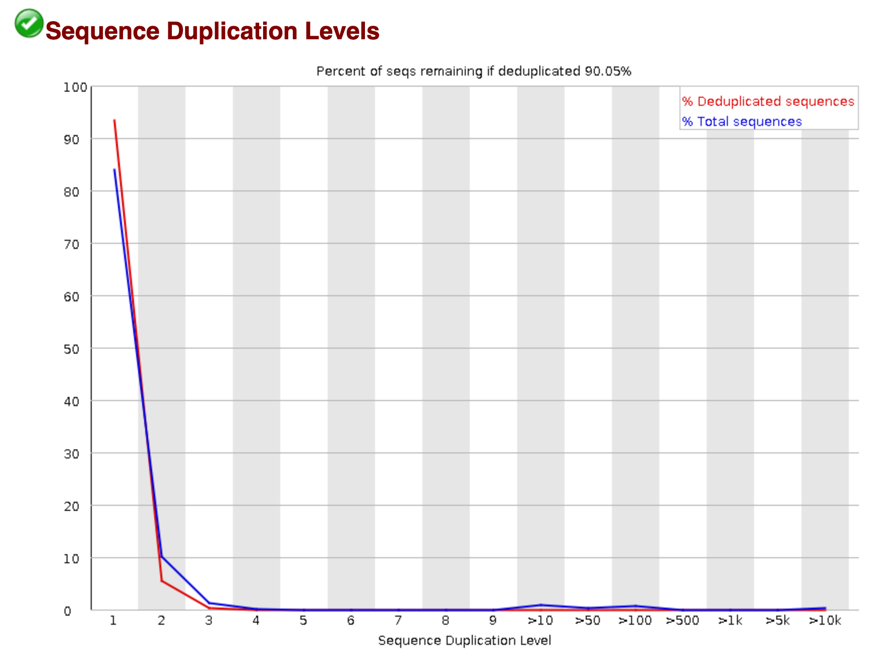
FastQC - Sequence Duplication Levels

Slide 16
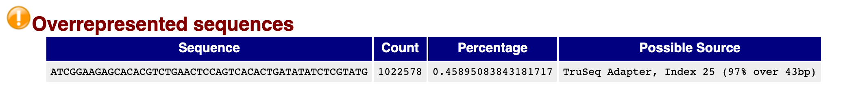
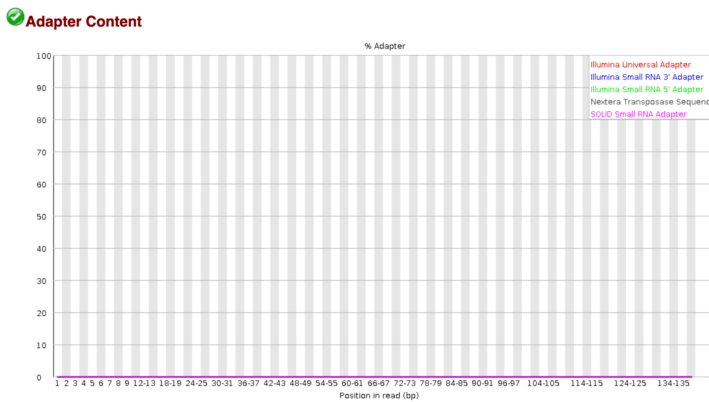

Slide 17
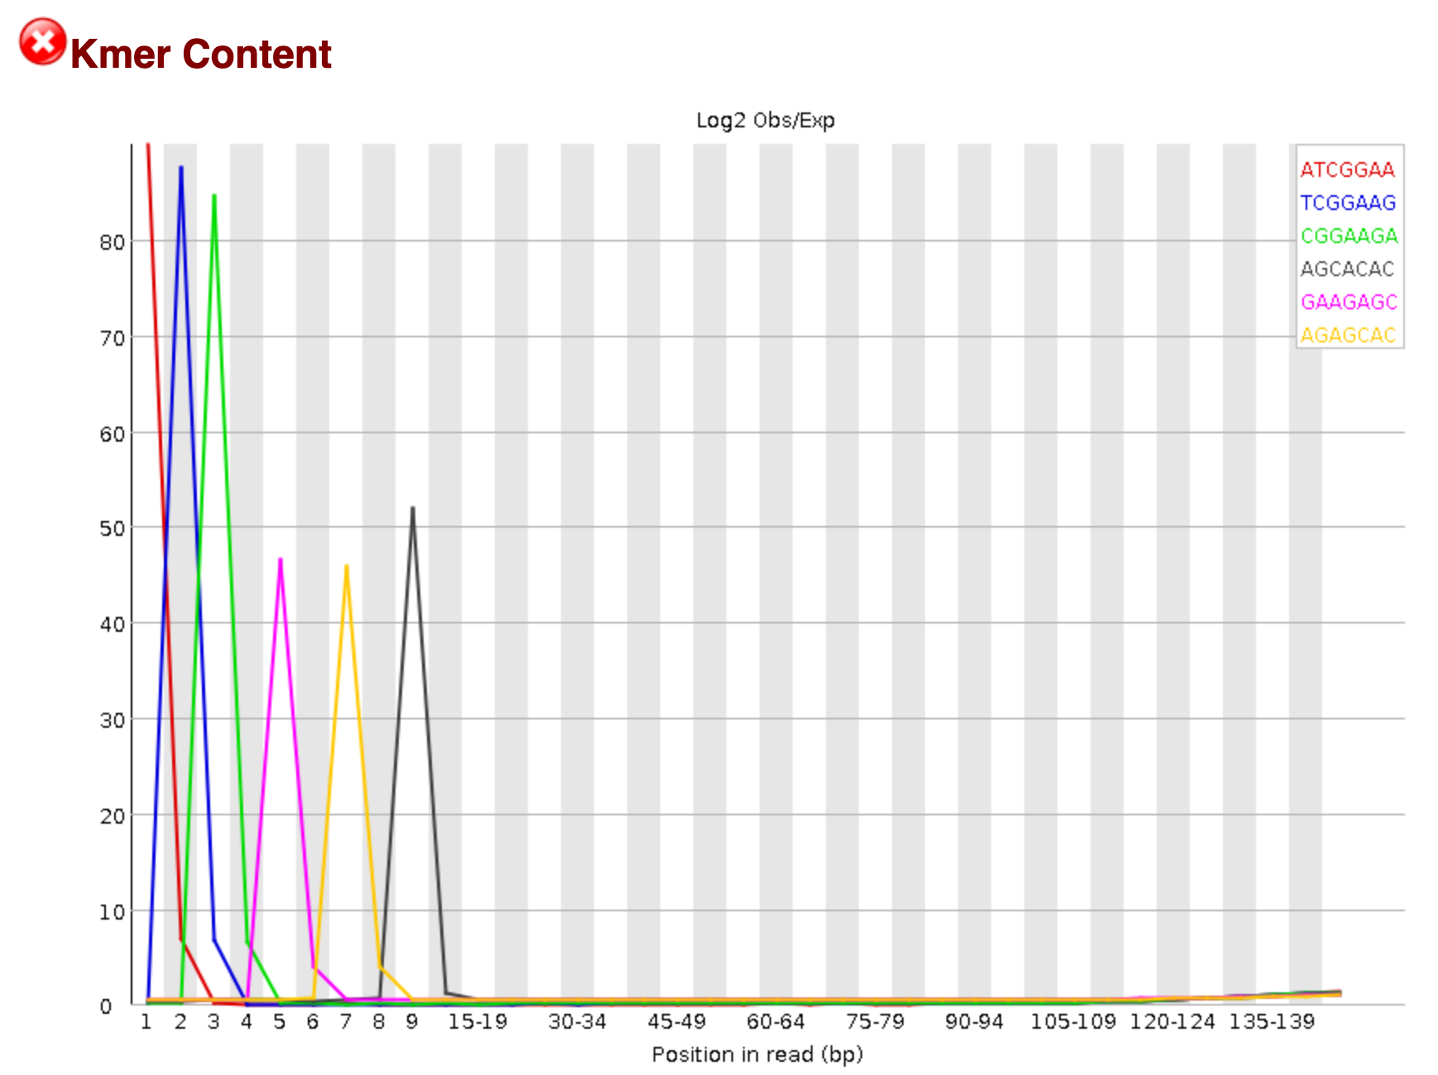
FastQC – Kmer Content
Notes:
Problem with adapter sequence

Slide 18
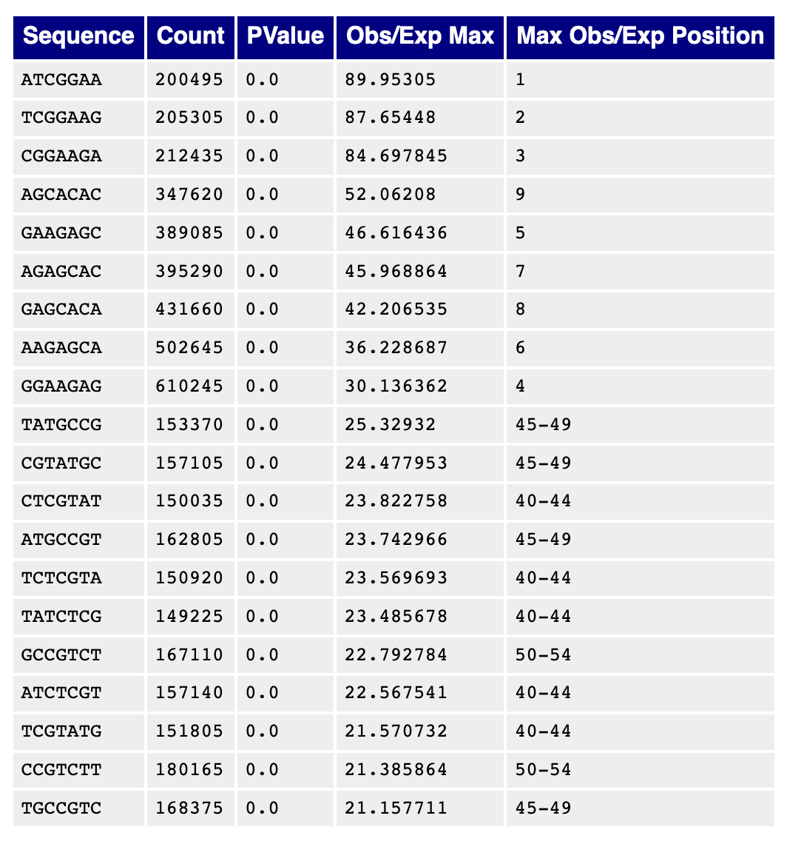
FastQC

